Slide 1
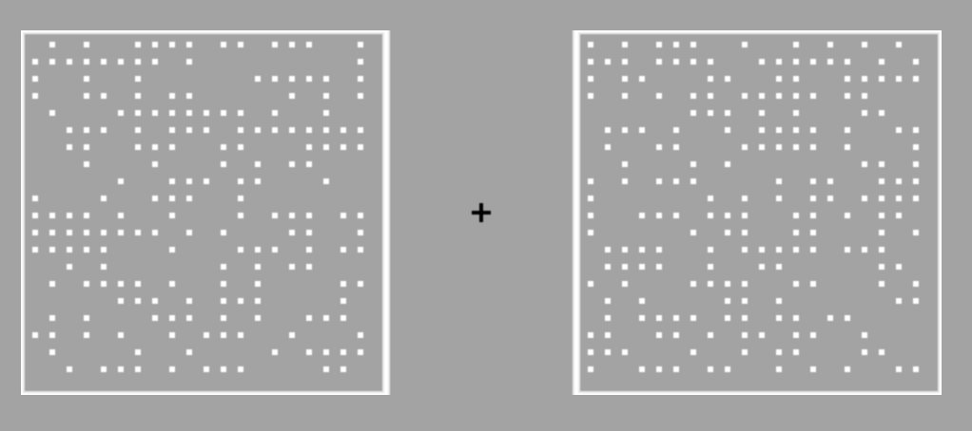
Hello and thank you for participating in this study!
In each trial of this task you will see two boxes containing dots, like this:
It is your task to determine which one contains more dots. In this case the right box contains more dots.
[Click Next to continue]

Slide 2
As you can see, it can sometimes be difficult to decide which one contains more dots.
To make it easier, there will be a black cross (circled in blue above) in the middle of the screen which you must fix your gaze on as you do the task.
[Click Next to continue]

Slide 3
In each trial, after the stimulus presentation, you are simply asked to give your response about the task.
To choose which box contained the most dots and express how confident you are, you will use a scale like the one above.
[Click Next to continue]

Slide 4
If you think the LEFT box contained more dots, place the cursor on the LEFT part of the scale using the mouse
and then click Continue to confirm your choice.
[Click Next to continue]

Slide 5
If you think the RIGHT box contained more dots, place the cursor on the RIGHT part of the scale using the mouse
and then click Continue to confirm your choice.
[Click Next to continue]

Slide 6
By placing the cursor farther away from the centre of the scale you indicate a higher confidence.
[Click Next to continue]

Slide 7
By placing the cursor closer to the centre of the scale you indicate a lower confidence.
[Click Next to continue]

Slide 8
Please try to report your confidence as reliably as possible!!
This means:
If you indicate to be 100% confident, you are 100% sure this is the answer!
[Click Next to continue]

Slide 9
Please try to report your confidence as reliably as possible!!
This means:
If you indicate you are 50% confident, you don’t know the answer at all and are purely guessing it was left or right.
[Click Next to continue]

Slide 10
Should I always place the cursor in the same position?
No!
Try not to be overconfident OR under-confident. Please try to use the confidence scale in a meaningful way.
The best strategy is
to go toward the extremes of the scale only when you are truly confident or
to go toward the middle of the scale only when you are truly unsure.
The best way to do this task is thus to truthfully report how sure you are you chose correctly using the confidence scale.
You will receive points based on accurately reporting your confidence when you are either correct or incorrect. The only way to maximise your score is to be honest in your confidence!
[Click Next to continue]

Slide 11
Please remember:
Click on the side of the scale corresponding to the box with the most dots.
If you are INCORRECT you will see a message on screen telling you were incorrect. If no message appears, you were correct.
Use the confidence scale appropriately and report your true confidence.
Click continue to confirm.
Do not randomly guess your choice.
Do not be overconfident or under-confident. Just report your true confidence.
Only your final position, i.e. the one you confirm with the spacebar, will count.
You will now start a practice trial.
[Click Next to continue]

Slide 12
[Click Next to start the practice]

Slide 13
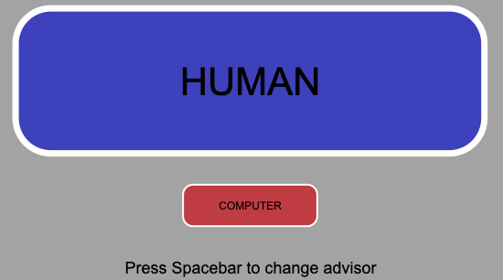
Well done!
We'll now move on to the main experiment. This will involve the same dot task and again you will get advice from the same Human and Computer advisors. However, on some trials you will get a choice of advisor: On these trials, an advisor will be randomly selected but you can change to the other advisor if you prefer by pressing the spacebar. You'll see a screen like this:
You have 1.5 seconds to change advisors. If you are happy with the allocated advisor (the advisor shown in the larger box, as with the human advisor above), you do not have to do anything.
[Click Next to continue]

Slide 14
Before you begin:
If you choose the HUMAN advisor:
You will be told the answer (LEFT/RIGHT) chosen by a real person who did the task earlier and saw the exact same stimulus that you just saw.
If you choose the COMPUTER advisor:
You will be told the answer (LEFT/RIGHT) chosen by a computer algorithm that is applied to the exact same stimulus that you just saw.
Their advice may sometimes be incorrect. The advice will always come from the same person and same computer algorithm across the whole experiment, so you can learn how reliable each source of advice is.
It is up to you to decide which advisor to choose to get advice from. It is also up to you how much you take the advice into account when making your final decision.
[Click Next to continue]

Slide 15
Each trial will start with two boxes of dots, just as you practiced at the start of the experiment. Then you’ll be asked for an initial judgment of which box contained more dots, and how confident you are in your judgment.
Then you’ll be provided with an advisor. If you see both advisors on the screen, you have the option to switch advisors by pressing the spacebar. Remember: the advice always comes from the same person and the same algorithm. Use the mouse to click on the advisor you want to receive advice from.
After seeing your chosen advice, you will then be asked for a final decision (LEFT or RIGHT) and again how confident you are in this decision. Your previous answer and confidence will be displayed, and you can adjust this answer and/or confidence prior to your final answer.
Confirm your final answer by clicking Continue. Only this final answer will count towards your percent correct.
[Click Next to continue]

Slide 16
On a small number of trials you will not be given a choice of advice. Instead you will only see one advisor on the screen (either from the person or the computer algorithm – the same person and algorithm you are choosing between on the other trials).
[Click Next to continue]

Slide 17
You will now start the Experimental Phase, which is made up of 4 blocks of trials in total.
[Click Next to start the Experimental Phase]

Slide 18
The End!
Thank you so much for participating!
You will now be redirected.

Slide 19


Well done!
Now you will have the opportunity to practice the task with an advisor.
On each trial you will get advice about the correct answer before you commit to a final choice.
The advice will come either from a person or from a computer algorithm. Each advisor will simply tell you which box they think has more dots.
[Click Next to continue]

Slide 20
Before you begin:
On every trial, you will receive help from one advisor: either the computer or human.
When the HUMAN is your advisor:
You will be told the answer (LEFT/RIGHT) chosen by a real person who did the task earlier and saw the exact same stimulus that you just saw.
The HUMAN advisor is a past participant who completed the study without the assistance of advisors.
When the COMPUTER is your advisor:
You will be told the answer (LEFT/RIGHT) chosen by a computer algorithm that is applied to the exact same stimulus that you just saw.
The COMPUTER advisor consists of an algorithm that analyses the given stimulus and produces an answer based on pre-determined criteria.
[Click Next to continue]

Slide 21
Your advisors may sometimes be incorrect. The advice will ALWAYS come from the same person and same computer algorithm across the whole experiment, so you can learn how reliable each source of advice is.
Each trial will start with two boxes of dots, just as you practiced at the start of the experiment. Then you’ll be asked for an initial judgment of which box contained more dots, and how confident you are in your judgment.
Then you’ll be given either computer or human advice. Remember: the advice always comes from the same person and the same algorithm. Use the mouse to click on the advisor when you are ready to see their advice.
After seeing the advice, you will then be asked for a final decision (LEFT or RIGHT) and again how confident you are in this decision. Your previous answer and confidence will be displayed, and you can adjust this answer and/or confidence prior to your final answer.
Confirm your final answer by clicking Continue. Only this final answer will count towards your final accuracy (and feedback) and overall percent correct.
[Click Next to continue]

Slide 22
You will now start the 2nd Practice Phase, which is made up of 1 block of trials, which should take around 5-10 minutes to complete.
Click Next to start the 2nd Practice Phase

Slide 23
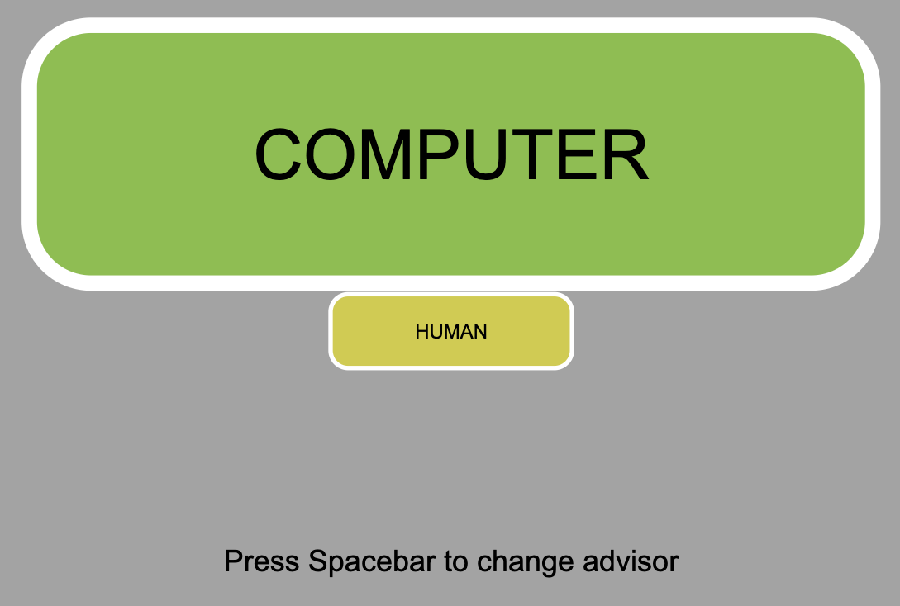
Well done!
The next phase of the experiment will continue using the same task as well as the same advisors you used in the last block of trials.
However, on some trials, you will be assigned an advisor for the trial and can choose if you want to switch to the other advisor (as per the image below). The bottom advisor (larger in size) is the initial one assigned. To change advisor, press the spacebar before the timer runs out. If you would like to keep the assigned advisor, simply let the timer run out.
In other trials only one advisor option will be given.
It is up to you to decide which advisor to choose to get advice from. It is also up to you how much you take the advice into account when making your final decision.
[Click Next to continue]

Slide 24
You will now start the Experimental Phase, which is made up of 4 blocks of trials in total, each taking around 5-10 minutes to complete.
Click Next to start the Experimental Phase

